Slide 1
Artificial Intelligence
Lecture 1

Slide 2
Resources
Core Resources
  Artificial Intelligence: A Modern Approach, by Stuart Russell and Peter Norvig, Prentice Hall. 4th Ed.
Reference Resources
  Artificial Intelligence Basics: A Non-Technical Introduction, Taulli, T., Apress, 2019.
  Artificial Intelligence: Structures and Strategies for Complex Problem Solving, George F. Luger, Addison Wesley Publisher.

Slide 3
Today’s Lecture
What is AI?
  Acting humanly (Turing Test approach)
  Thinking humanly (Cognitive Modelling approach)
  Acting rationally (Rational Agent approach)
  Thinking rationally (Laws of Thought approach)
  Weak AI vs Strong AI
Problem Solving using Searching
  Problem Definition
  Uninformed Search
    Breadth-first Search
    Depth-first Search
    Iterative Deepening Search

Slide 4

What is AI?
Acting Humanly
Acting Rationally
“The art of creating machines that perform functions that require intelligence when performed by people” (Kurzweil, 1990)
A field of study that seeks to explain and emulate intelligent behavior in terms of computational processes” (Schalkol, 1990)
The exciting new effort to make computers thinks … machine with minds, in the full and literal sense”
(Haugeland 1985)
Thinking Rationally
Thinking Humanly
“The study of mental faculties through the use of computational models”
(Charniak et al. 1985)

Slide 5
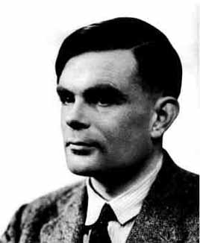
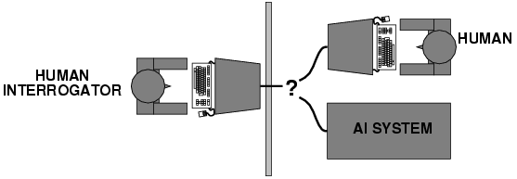
Acting humanly
The Turing Test approach
Alan Turing, born at 23rd of june, 1912
Computing Machinery and Intelligence, written by Alan Turing and published in 1950 in Mind, is a paper on the topic of artificial intelligence in which the concept of what is now known as the Turing test was introduced to a wide audience.
The Turing Test
How can we evaluate intelligence?
  Turing [1950]: a machine can be deemed intelligent when its responses to interrogation by a human are indistinguishable from those of a human being.

Slide 6
Turing Test
Turing begins the 1950 paper with the claim, "I propose to consider the question 'Can machines think?’
The traditional approach to such a question is to start with definitions, defining both the terms "machine" and "intelligence".
In essence he proposes to change the question from "Can machines think?" to "Can machines do what we (as thinking entities) can do?“
The conversation would be limited to a text-only channel such as a computer keyboard and screen so the result would not depend on the machine's ability to render words as speech.

Slide 7
Turing Test: Criticism
What are some potential problems with the Turing Test?
  Some human behavior is not intelligent
    The temptation to lie, a high frequency of typing mistakes.
    A machine that mimics these errors might pass as human, but that doesn’t prove it’s intelligent.
  Some intelligent behavior may not be human
    If it were to solve a computational problem that is practically impossible for a human to solve.
    A strict turing test would penalize the AI for being too smart because it doesn’t act human-like.

Slide 8
Reverse Turing test and CAPTCHA
A reverse Turing test is a Turing test in which the objective or roles between computers and humans have been reversed.
In other words, a computer administers a test to determine if the subject is or is not human.
As of 2004, such procedures, called CAPTCHAs (Completely Automated Public Turing test to tell Computers and Humans Apart), are used in some anti-spam systems to prevent automated bulk use of communications systems.

Slide 9
Thinking humanly
The cognitive modelling approach
The interdisciplinary field of cognitive science brings together computer models from AI and experimental techniques from psychology to try to construct precise and testable theories of the workings of the human mind. Research methods include introspection, psychological experiments etc.
We need to get inside the actual workings of human minds.
There are two ways to do this: through
  Introspection: i.e. trying to catch our own thoughts as they go by.
  or through psychological experiments.
Problems:
  It may be impossible to identify the detailed structure of human problem solving using only externally-available data.

Slide 10
Thinking Rationally:
The Laws of Thought Approach
Ensure that all actions performed by computer are justifiable (“rational”)
Rational = Conclusions are provable from inputs and prior knowledge
    For example, “Tom is a man; all men are mortal; therefore Tom is mortal.”
    There are two obstacles to this approach.
      First, It is not easy to take informal knowledge and state in the formal terms required by logical notation.
      Second, solving problem principally is different from doing it in practice. Even problems with certain dozens of fact may exhaust the computational resources of any computer unless it has some guidance as which reasoning step to try first.
Facts and Rules in Formal Logic
Theorem Prover

Slide 11
Acting rationally
Rational agent
An agent is anything that can be viewed as perceiving its environment through sensors and acting upon that environment through actuators.
A human agent has eyes, ears, and other organs for sensors and hands, legs, vocal tract, and so on for actuators.
A robotic agent might have cameras and infrared range finders for sensors and various motors for actuators.
A software agent receives keystrokes, file contents, and network packets as sensory inputs and acts on the environment by displaying on the screen, writing files, and sending network packets.
A rational agent is one that acts to achieve the best expected outcome
  Goals are application-dependent and are expressed in terms of the utility of outcomes.
  Being rational means maximizing your expected utility.
  In practice, utility optimization is subject to the agent’s computational constraints.

Slide 12
Weak and Strong AI
Acting Humanly
Acting Rationally
“The art of creating machines that perform functions that require intelligence when performed by people” (Kurzweil, 1990)
A field of study that seeks to explain and emulate intelligent behavior in terms of computational processes” (Schalkol, 1990)
Strong AI
Weak AI
Thinking Humanly
Thinking Rationally
The exciting new effort to make computers thinks … machine with minds, in the full and literal sense”
(Haugeland 1985)
“The study of mental faculties through the use of computational models”
(Charniak et al. 1985)

Slide 13
Weak AI vs Strong AI
Weak AI (also known as "Narrow AI" or "Applied AI"):
Weak AI refers to AI systems that are designed and trained for a specific task or a narrow range of tasks.
These systems excel in one area, such as playing chess, recognizing faces in images, or understanding natural language.
Weak AI systems are typically not capable of performing tasks outside of their narrow domain of expertise.
For example, a chess-playing program like IBM's Deep Blue, a voice-activated virtual assistant like Amazon's Alexa, or a self-driving car like Waymo's technology are all examples of weak AI.

Slide 14
Weak AI vs Strong AI
Strong AI (also known as "General AI" or "True AI"):
Strong AI refers to AI systems that have the ability to understand, learn, and reason across a broad range of tasks, similar to human intelligence.
These systems would be capable of thinking and understanding in the way that humans do, potentially having consciousness and emotions.
Strong AI would be able to perform any intellectual task that a human can, from understanding and generating natural language to solving complex problems and even exhibiting creativity.
The existence of strong AI is still hypothetical, and no AI system currently exists that fits the criteria of strong AI.

Slide 15
Problem Solving using Searching

Slide 16
Problem Solving using Searching
Problem-solving using searching refers to a process where you systematically explore potential solutions to a problem in order to find the best one.
It involves searching through a space of possible solutions, evaluating their quality, and making decisions based on this evaluation.
This approach is commonly used in artificial intelligence and operations research.

Slide 17
Problem Definition
State space: all states reachable from the initial state by any sequence of actions
Initial state: starting point
Operator: description of an action
Goal test: which the agent can apply to a single state description to determine if it is a goal state.
Path: sequence of actions leading from one state to another
Solution Cost: assign a cost to a path which is the sum of the costs of the individual actions along the path.

Slide 18
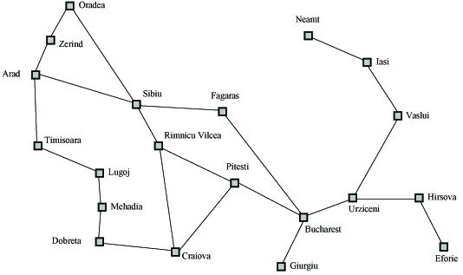
State Space - Search Example
A search problem is defined by the
Initial state (e.g., Arad)
Operators (e.g., Arad -> Zerind, Arad -> Sibiu, etc.)
Goal test (e.g., at Bucharest)
Solution cost (e.g., path cost)

Slide 19
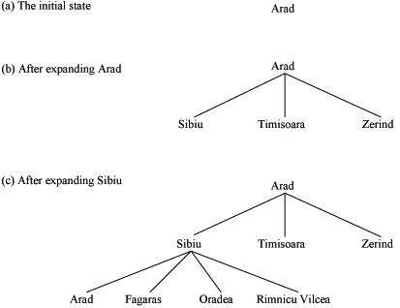
Search Problem Example (as a tree)
(start: Arad, goal: Bucharest.)

Slide 20
Uninformed/ Informed Searches
All search strategies are distinguished by the Order in which nodes are expanded.
Uninformed approach searches without the aid of any additional information about the problem other than the initial state and the set of possible actions. It aims to explore the entire search space systematically without using any knowledge or heuristics.
  Breadth-first search
  Depth-first search
  Iterative deepening search
This approach uses additional information, typically a heuristic, to guide the search. Heuristics provide an estimate of the cost to reach the goal, helping the search algorithm to focus on more promising areas of the search space.
  Greedy best-first search
  A* search

Slide 21
  Breadth-first search
Breadth first search (BFS), as the name implies, searches from the initial state breadth-wise.
That is it searches all the states in the tree level by level.
Only after exploring all the states in one level it will jump to the next level.
Once the solution is found the search stops.
The breadth first search is guaranteed to find the solution if one exists.

Slide 22
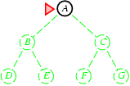
Breadth-first search
Expand shallowest unexpanded node

Slide 23
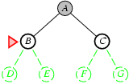
Breadth-first search
Expand shallowest unexpanded node

Slide 24
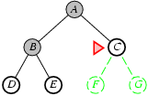
Breadth-first search
Expand shallowest unexpanded node

Slide 25
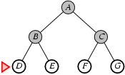
Breadth-first search
Expand shallowest unexpanded node

Slide 26
Breadth-first searching
A breadth-first search (BFS) explores nodes nearest the root before exploring nodes further away
For example, after searching A, then B, then C, the search proceeds with D, E, F, G
Node are explored in the order A B C D E F G H I J K L M N O P Q
J will be found before N
A
B
C
D
E
F
G
H
I
J
K
L
M
N
O
P
Q

Slide 27
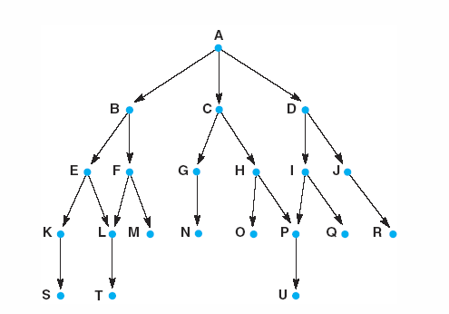
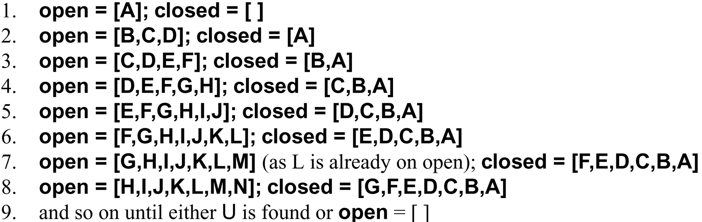
A trace of
breadth-first algorithm
B is not the goal.
Put his children onto the queue.
Put him in closed. He is done.
|
|
|
Items between red bars are siblings.
|
|
|
|
|
|
|
|
|
|
|
|
goal is reached or open is empty.

Slide 28
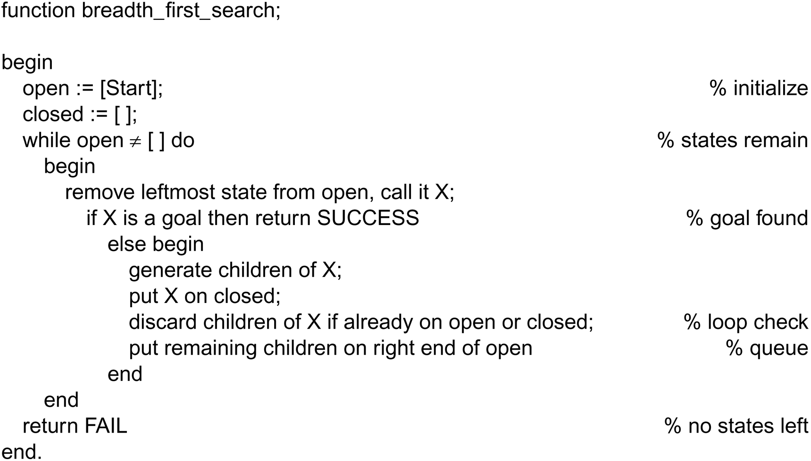
Breadth-first search algorithm
Nodes are lining up to be visited in open.
closed keeps track of all the nodes visited already.

Slide 29
Depth-first search
Explore only one branch deeper till the solution is found or there is no new state to explore and then start searching the adjacent level.
This technique is called depth first search (DFS).
By chance the solution exists in the first branch then depth first search can find the solution quickly.
If the solution exists in some other branches farther away, there won't be much difference between depth first search and breadth first search.

Slide 30
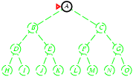
Depth-first search
Expand deepest unexpanded node

Slide 31
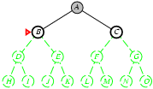
Depth-first search
Expand deepest unexpanded node

Slide 32
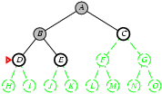
Depth-first search
Expand deepest unexpanded node

Slide 33
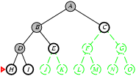
Depth-first search
Expand deepest unexpanded node

Slide 34
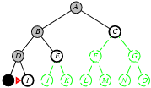
Depth-first search
Expand deepest unexpanded node

Slide 35
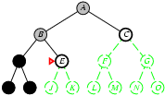
Depth-first search
Expand deepest unexpanded node

Slide 36
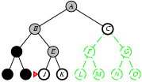
Depth-first search
Expand deepest unexpanded node

Slide 37
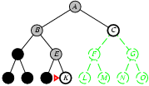
Depth-first search
Expand deepest unexpanded node.

Slide 38
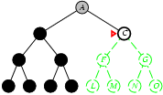
Depth-first search
Expand deepest unexpanded node.

Slide 39
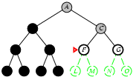
Depth-first search
Expand deepest unexpanded node.

Slide 40
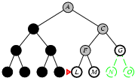
Depth-first search
Expand deepest unexpanded node.

Slide 41
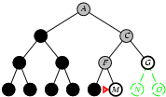
Depth-first search
Expand deepest unexpanded node

Slide 42
Depth-first searching
A depth-first search (DFS) explores a path all the way to a leaf before backtracking and exploring another path
For example, after searching A, then B, then D, the search backtracks and tries another path from B
Node are explored in the order A B D E H L M N I O P C F G J K Q
N will be found before J
A
B
C
D
E
F
G
H
I
J
K
L
M
N
O
P
Q

Slide 43
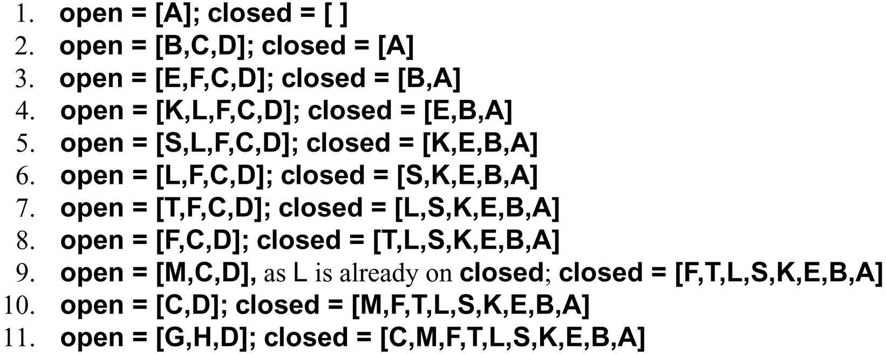
A trace of
depth-first algorithm
top of stack

Slide 44
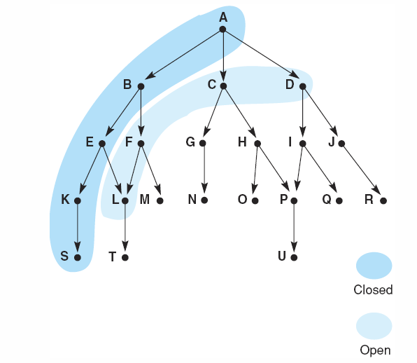
Snap shot at iteration 6
frontier
visited

Slide 45
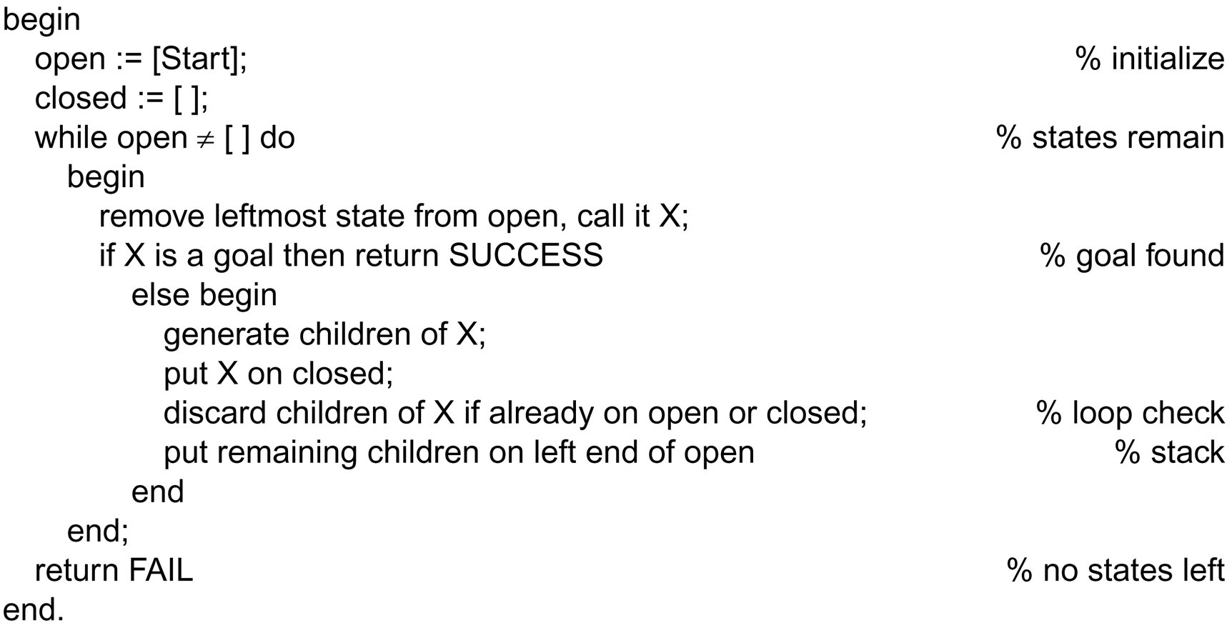
The depth-first search algorithm
This is the only difference between
depth-first and breadth-first.

Slide 46
Iterative Deepening Search
Depth-limited search avoids the pitfalls of depth-first search by imposing a cutoff on the maximum depth of a path.
This cutoff can be implemented with a special depth-limited search algorithm with operators that keep track of the depth.
Iterative deepening search is a strategy that sidesteps the issue of choosing the best depth limit by trying all possible depth limits: first depth 0, then depth 1, then depth 2, and so on.

Slide 47
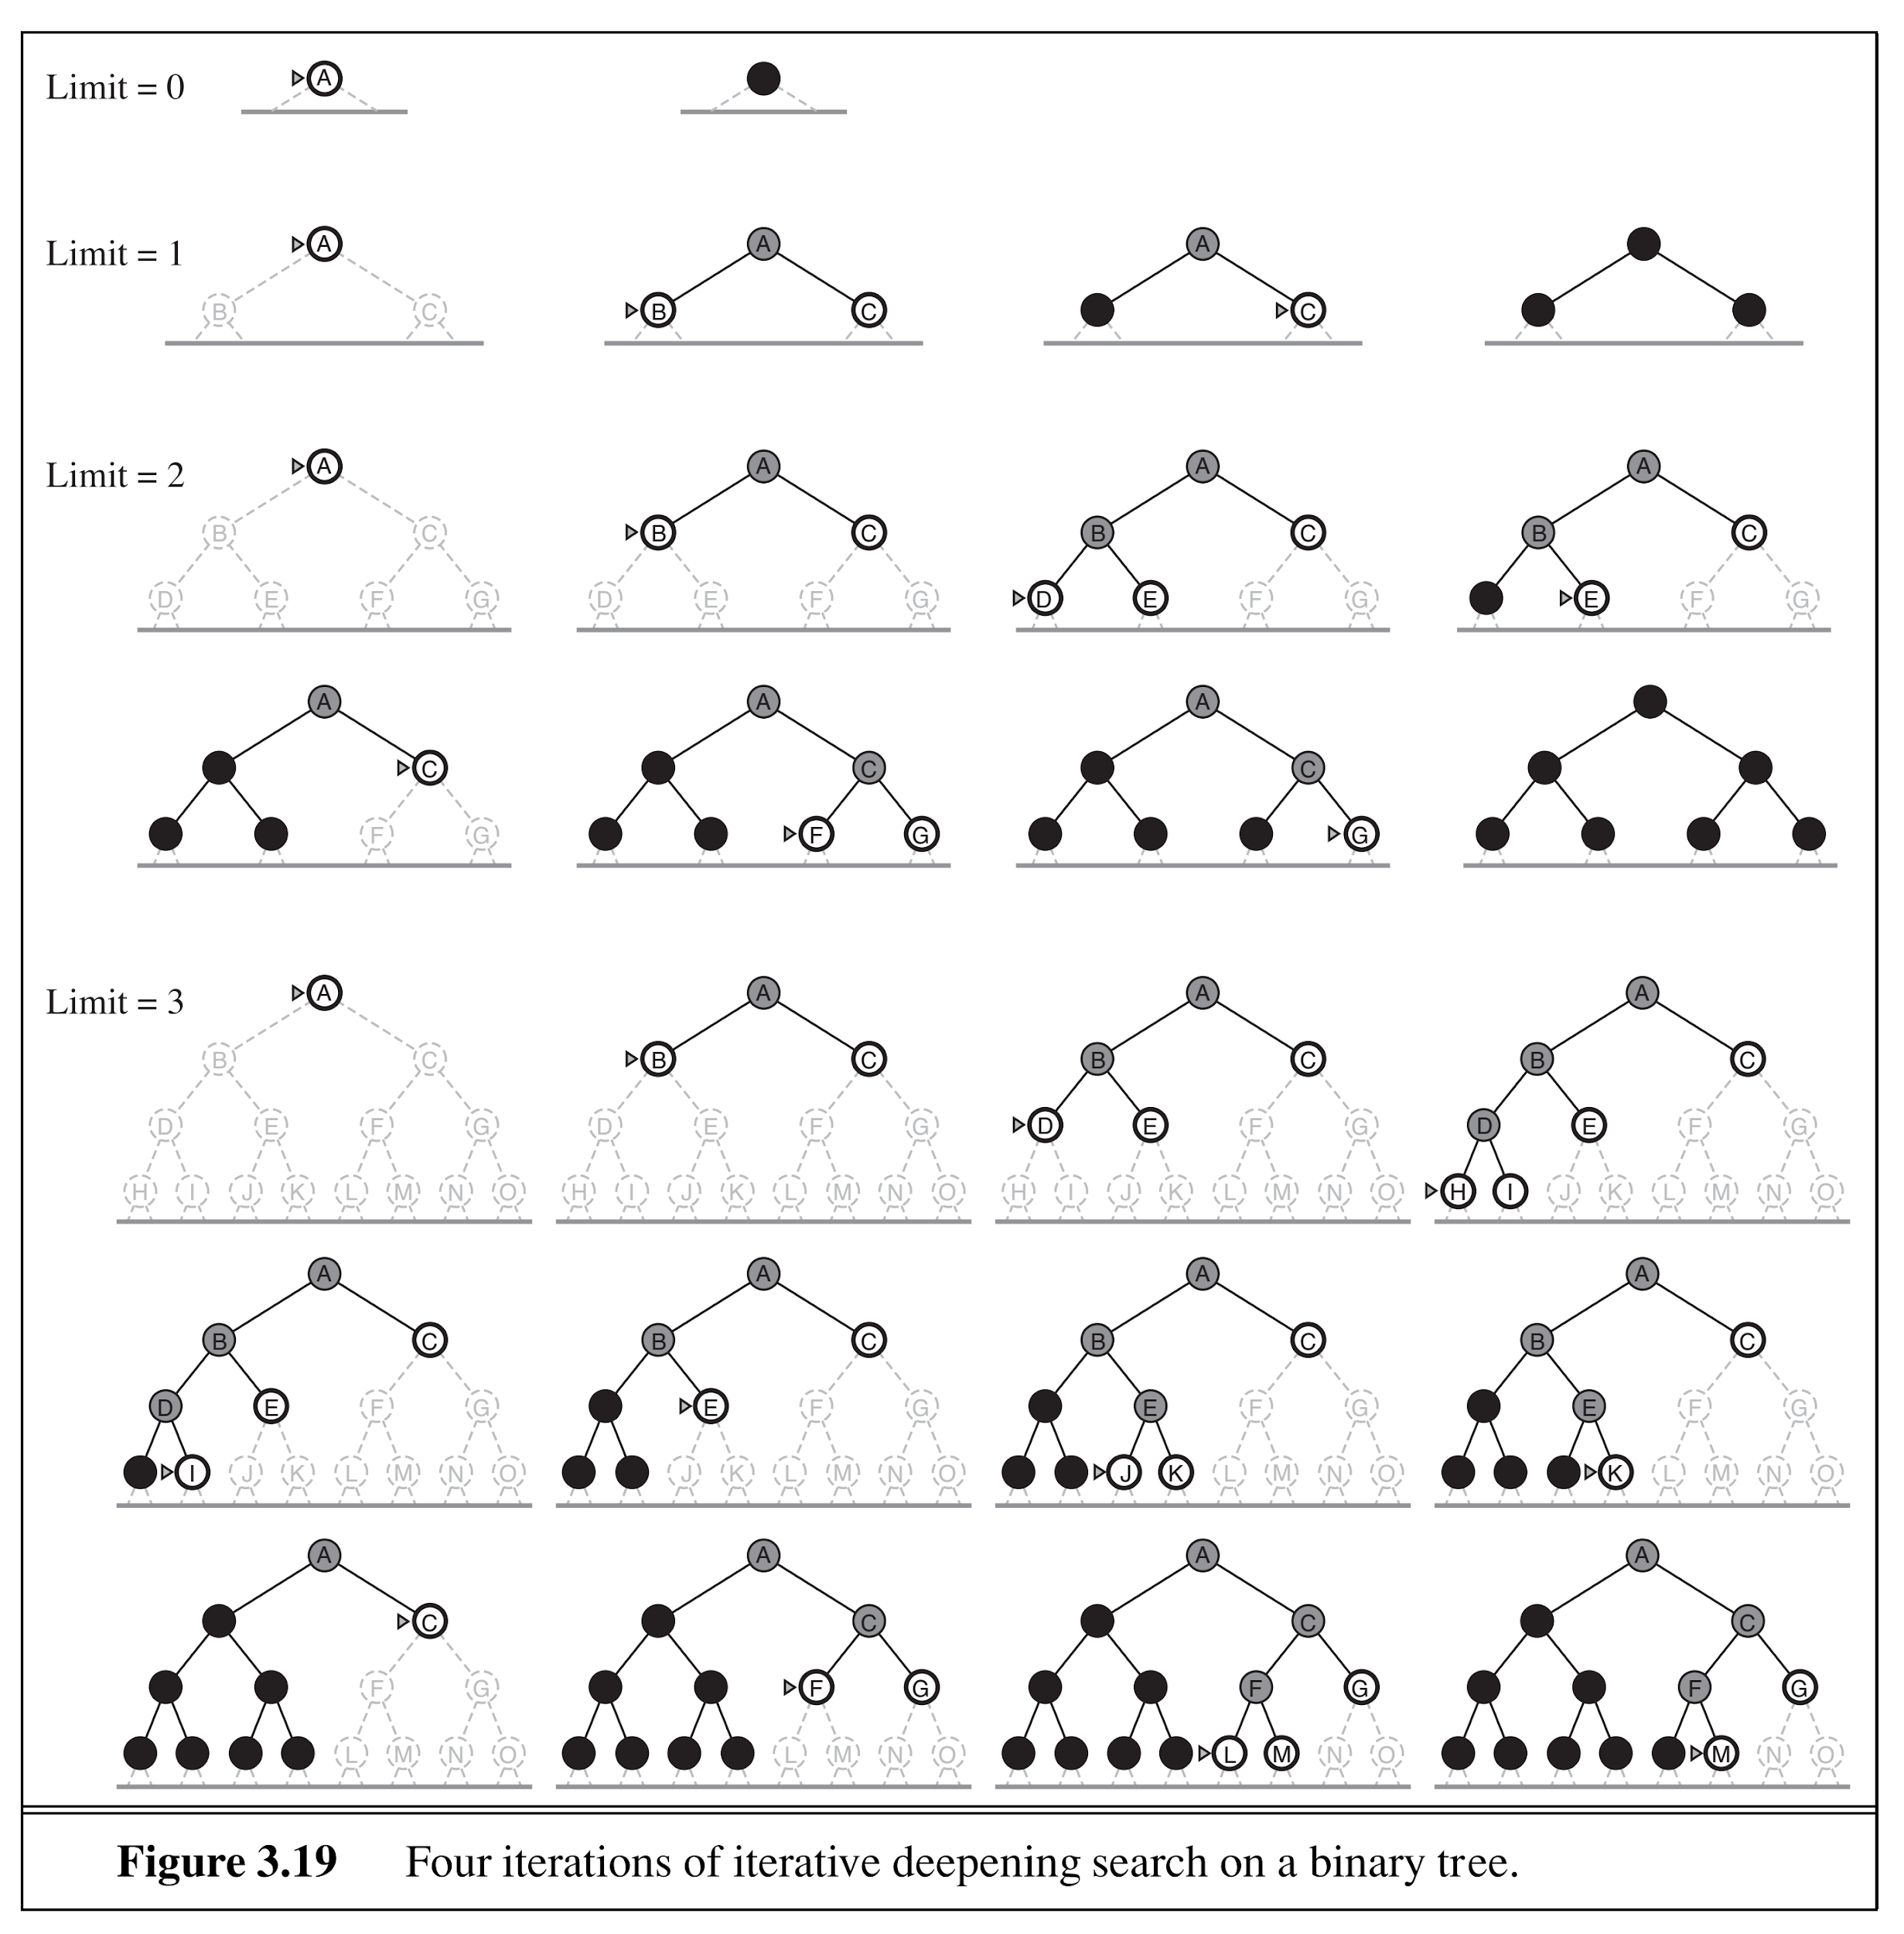
Iterative Deepening Search

Slide 48
Today’s Lecture
What is AI?
  Acting humanly
  Thinking humanly
  Acting rationally
  Thinking rationally
  Weak AI vs Strong AI
Problem Solving using Searching
  Problem Definition
  Uninformed Search
    Breadth-first Search
    Depth-first Search
    Iterative Deepening Search

